Slide 1

Startup Success Prediction model
Clelia Chelmi
Lilly Kolliniati
Source data: https://www.kaggle.com/datasets/manishkc06/startup-success-prediction/data

Slide 2


Agenda
Introduction
Data overview
Model overview
Summary and Next Steps

Slide 3


Introduction
Who are we?
What do we want to achieve?
Consultant agency:
Clelly & Co
Hired by the Finance Ministry
.
Look into Startup companies’ statistics
Create a prediction model if they will survive
.
Why?
Finance Ministry to provide assistance to upcoming, local enterprises to boost the economy and help struggling entrepreneurs

Slide 4



Data overview

Slide 5
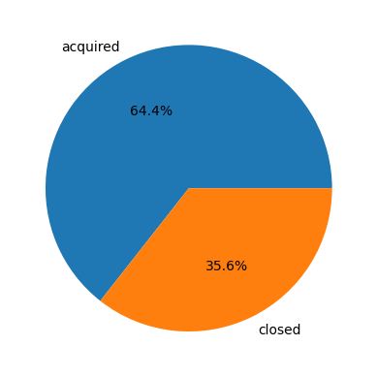
Overview of the data
Startup success prediction data
Columns | 49
Rows | 823
Target | Status: Acquired/Survived - Closed
Years
1984 - 2013 | Focus: 2000-2013

Slide 6
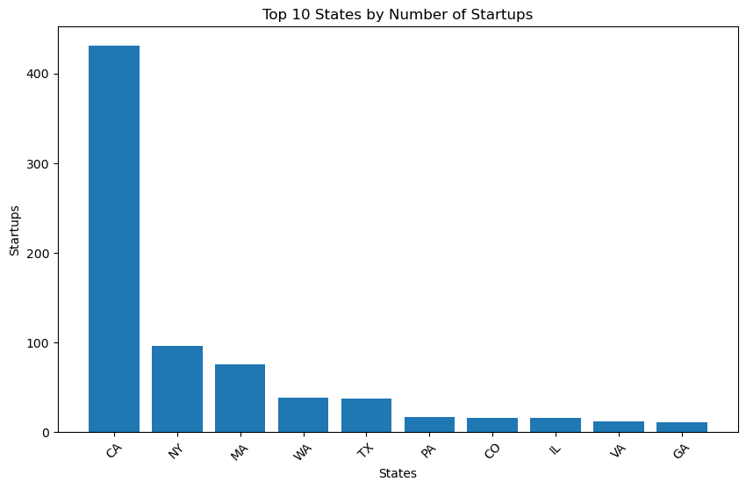
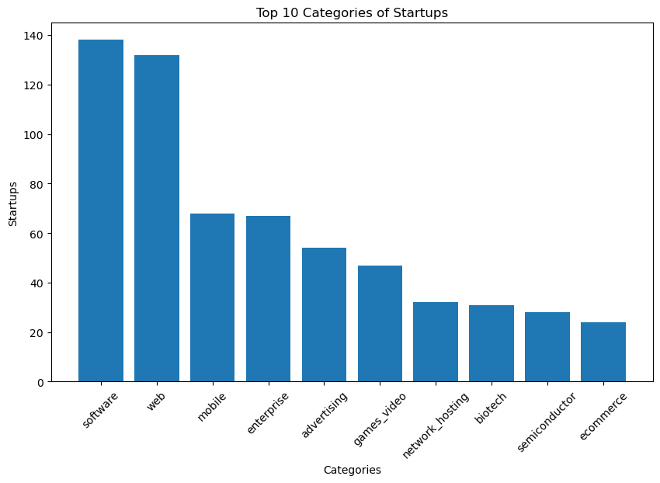
CHARTs

Slide 7
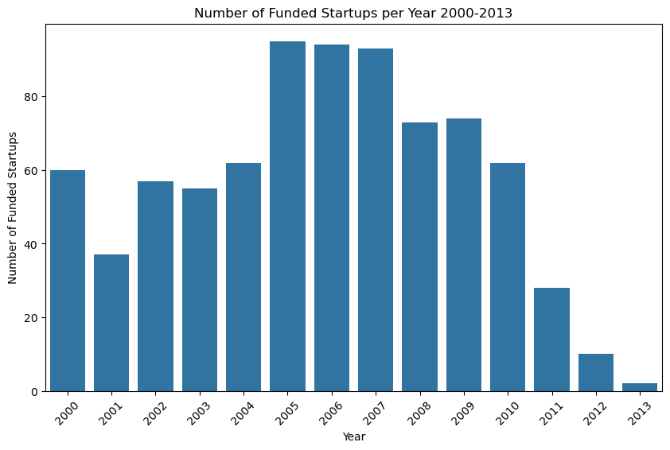
CHARTs

Slide 8
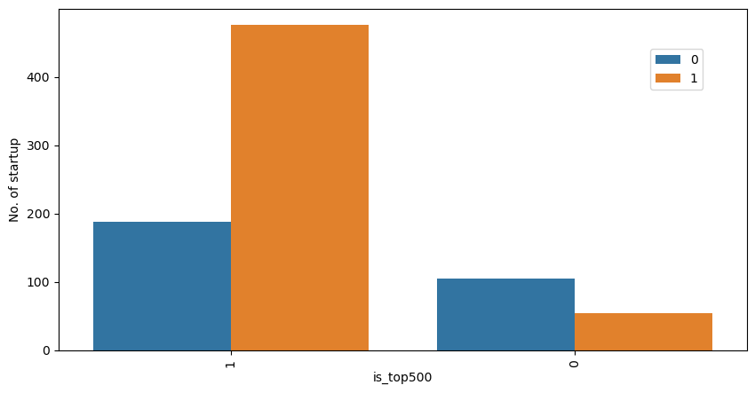
CHARTs

Slide 9
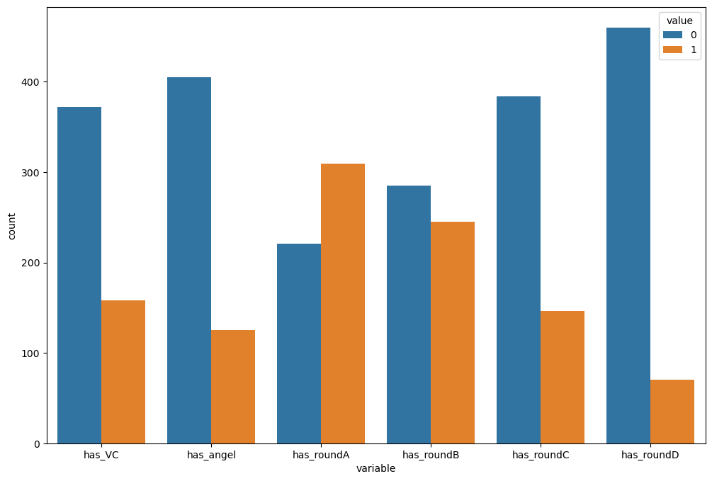
CHARTs

Slide 10
Model overview

Slide 11

The way to get started is to quit talking and begin doing.
Walt Disney

Slide 12
Model overview
DATA Preprocessing
Transformed categorical values to numeric
Transformed dates to right format
Expanded on dates
Null values: Where date values N/A transformed to 0
Dropped columns with high correlation, or not important information, such as company id, zip code

Slide 13
Model overview
Model initiation
 | Features* | Scaler** | Model*** | Recall score
Scenario 1 | All | Robust | Random Forest | 1 (1), 0.97 (0)
Scenario 2 | Feature Selection | Robust | Random Forest | 1 (1), 0.97 (0)
Scenario 3 | All X closure year | Robust | Random Forest | 0.57 (1), 0.87 (0)
Scenario 4 | Feature Selection X closure year | Robust | Random Forest | 0.53 (1), 0.90 (0)

Slide 14
FINAL MODEL SELECTION
 | Feature Selection | Scaler | Imbalanced data | Model
Final Model | Multi classification | Robust | Near Miss | Random Forest
 | K estimators Feature Selection | N estimators For Model
Final Model | 25 | 200

Slide 15
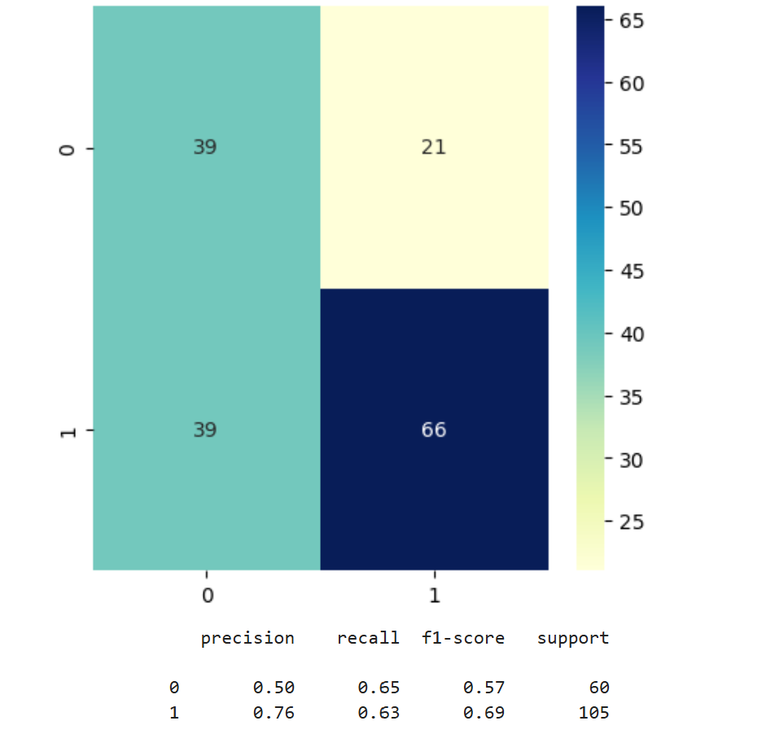
FINAL MODEL SCORE

Slide 16
conclusion
This project used machine learning to predict the success of startup companies based on various features such as relationships with investors, milestones, funding, industry.
We were able to successfully build a machine learning model that predicts the features that play a role in the success/failure of a startup. After testing all the models, we found that Random Forest Classifier (RFC) gave the best accuracy score of 0.65. Relationships with investors, how fast start ups reach their first milestone and funding are the most important predictors of startup success.

Slide 17




Next Steps
It's important to note that this analysis has several limitations, such as the potential for bias in the dataset and the limited set of features used to predict success. Future research could explore additional features or data sources to improve the accuracy of the model, as well as validate the model's predictions on real-world data.

Slide 18

Thank you

